Slide 1
PRESENTATION
ON
Game java project
Submitted To: Namarta Vij

Slide 2
Table content
Introduction of group
Introduction of project
Frontend
conclusion

Slide 3
Introduction of group
Group member：Sheng Kevin Yun ki
Group leader：Chong

Slide 4
Introduction of project
This project creates a Video Game Store Website using Java, focusing on game management, user accounts, reviews, and admin controls.
The system includes:
Game Management
User management
Admin management

Slide 5
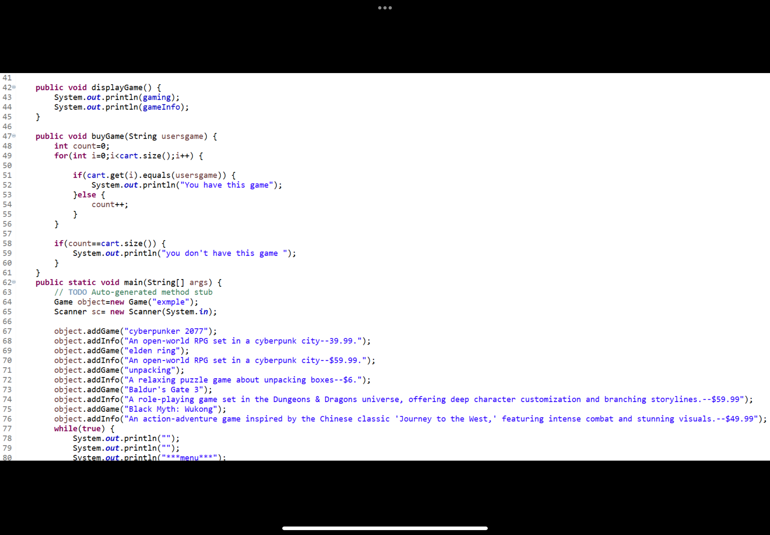
Game management
Function:
Manage the basic information of the game (such as ID, name, price, category, inventory, etc.).

Slide 6
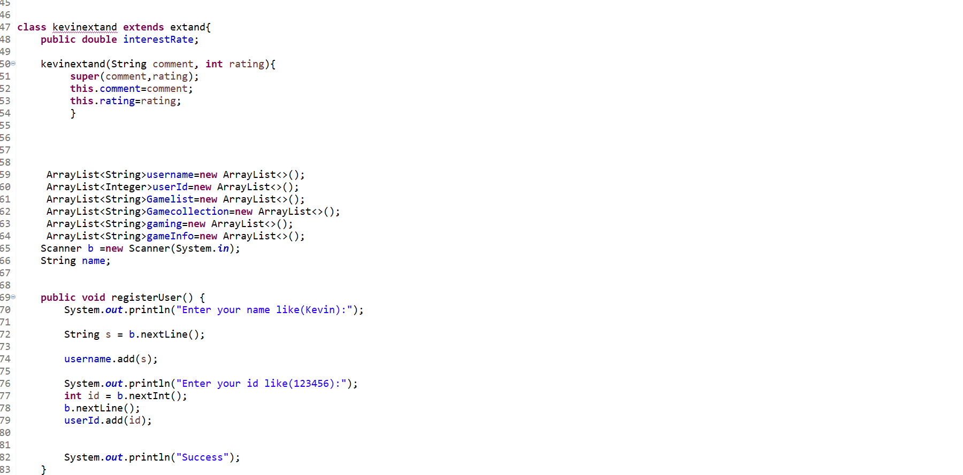
User Management
Function:
Stores user informations including email addresses along with the related usernames and game collections. Processes register, authentications, and display purchases for the client.

Slide 7
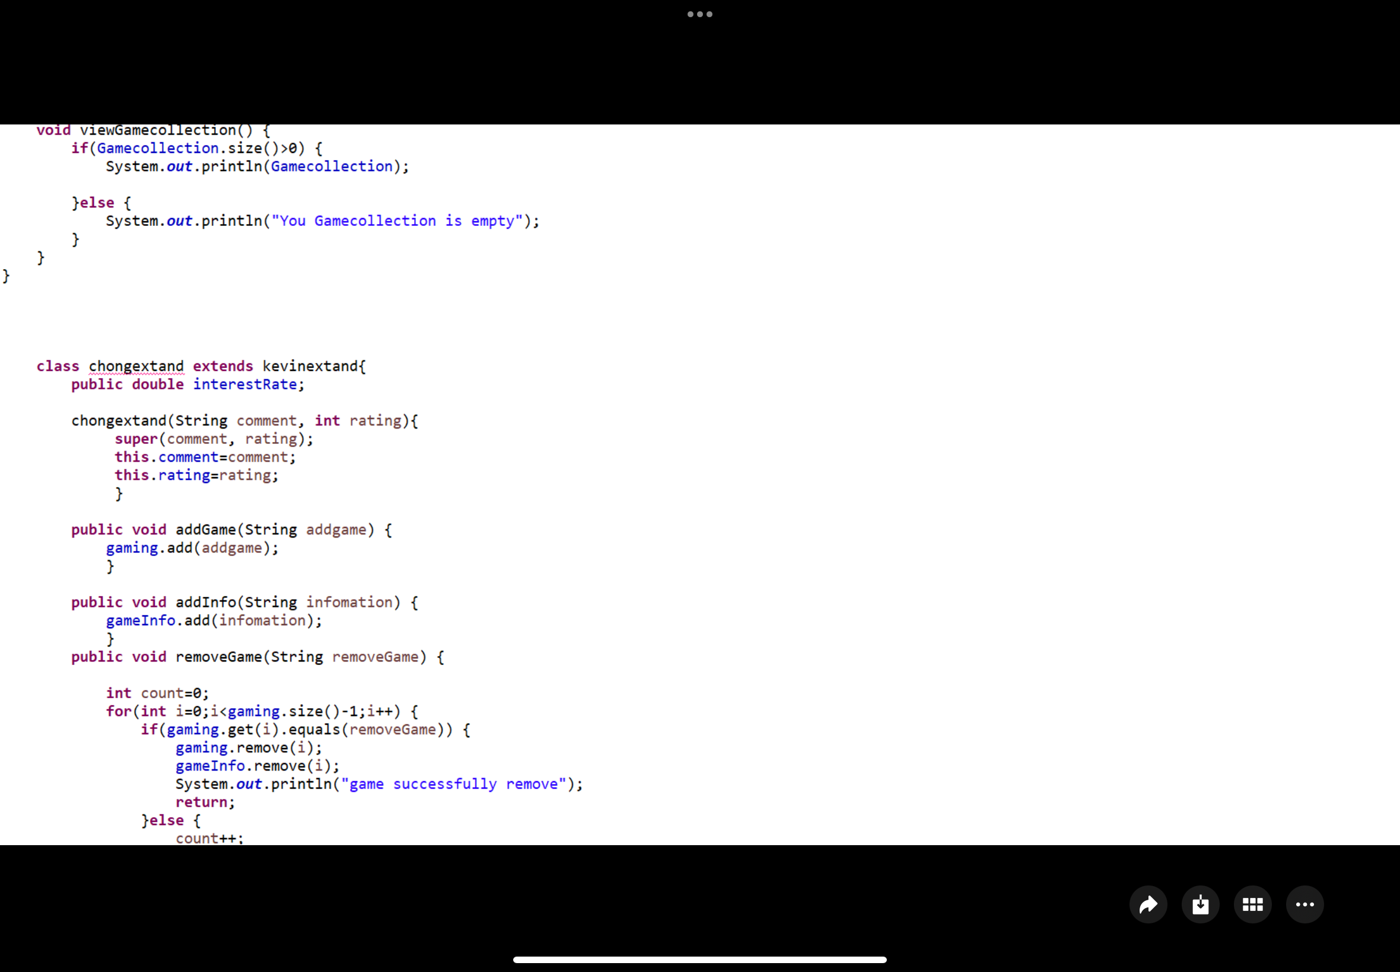
Admin management
Function:
Admin add game to the store
Remove game out of the store
Delete bad comment

Slide 8
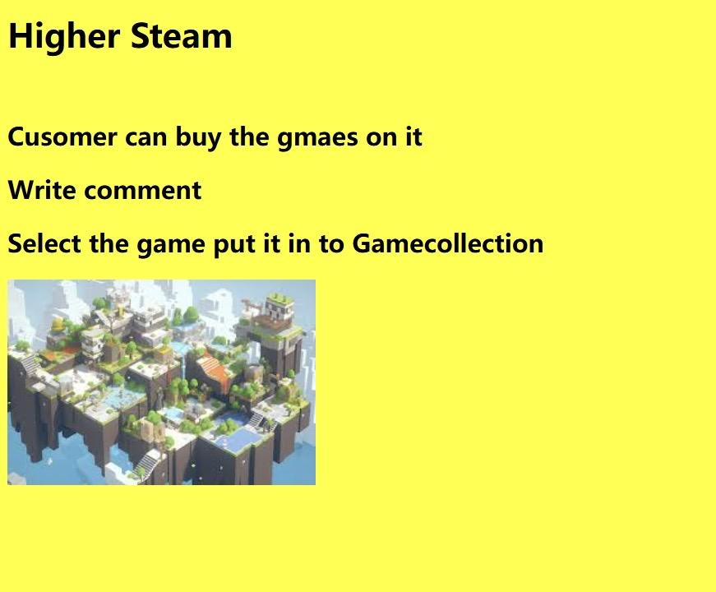
Frontend
Home Page
title for the game store website.
paragraph explaining what the game store offers
an image related to gaming management.

Slide 9
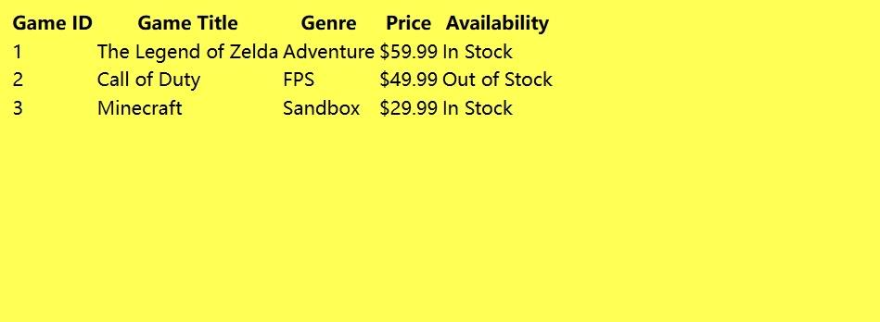
Frontend
2. Game Overview Table
o Game ID
o Game Title
o Genre
o Price
o Availability

Slide 10
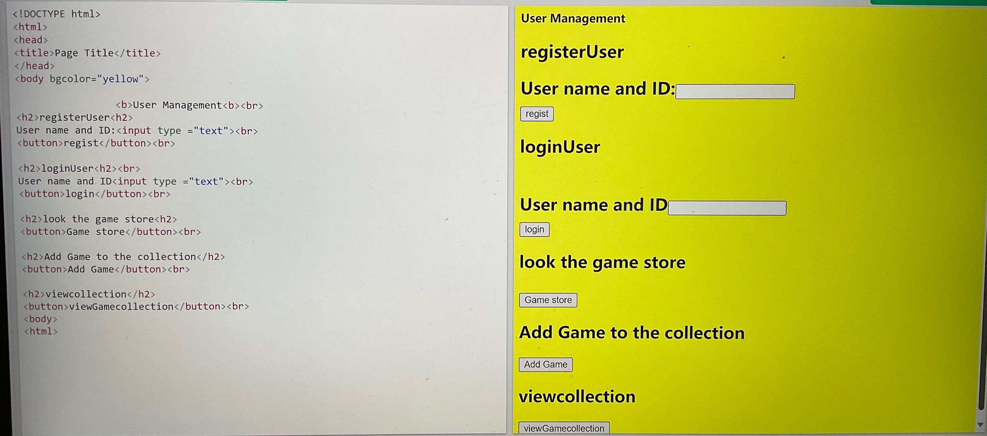
Frontend
3. User Account Section
create accounts browse games
add games
to their collection.
Some button for achieve function

Slide 11
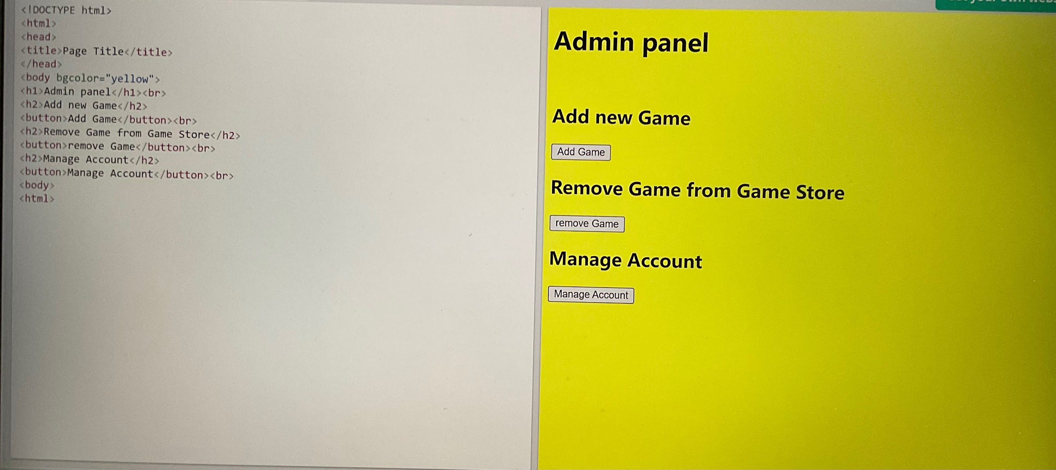
Frontend
4. Admin Section
A heading for the admin panel.
add new games remove games
manage user accounts.

Slide 12
Structure Conclusion
The project creates a online platform where users can explore, purchase, and review games. It includes a user system that lets players manage their game collections, share reviews, and connect with others who have similar interests. There is as well an admin system that allows the addition of games to the store, removal of reviews, and other administrative functions. The focus of this project is on designing and developing a video game store website using Java.

